Slide 1
Birds of the forest

Slide 2
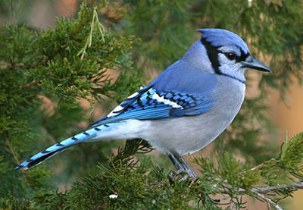


Slide 3
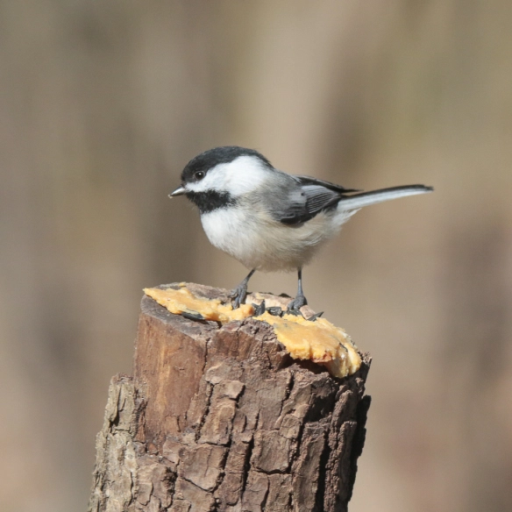

Slide 4
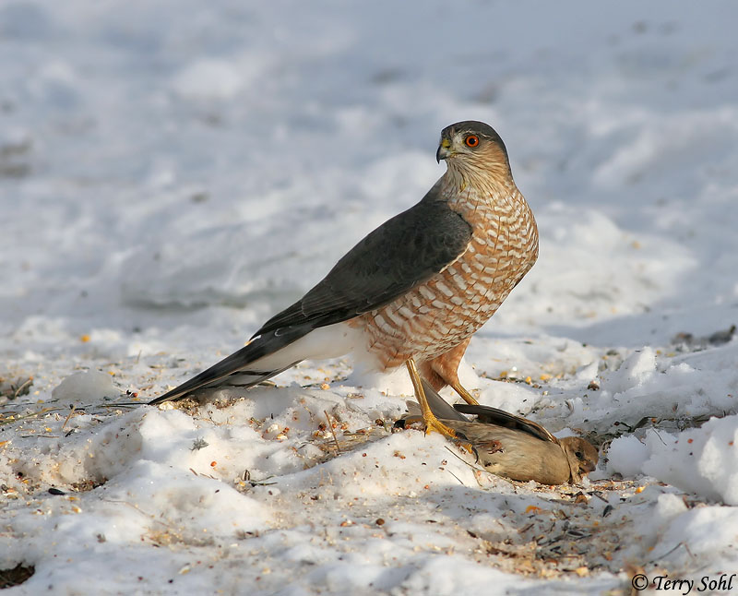

Slide 5
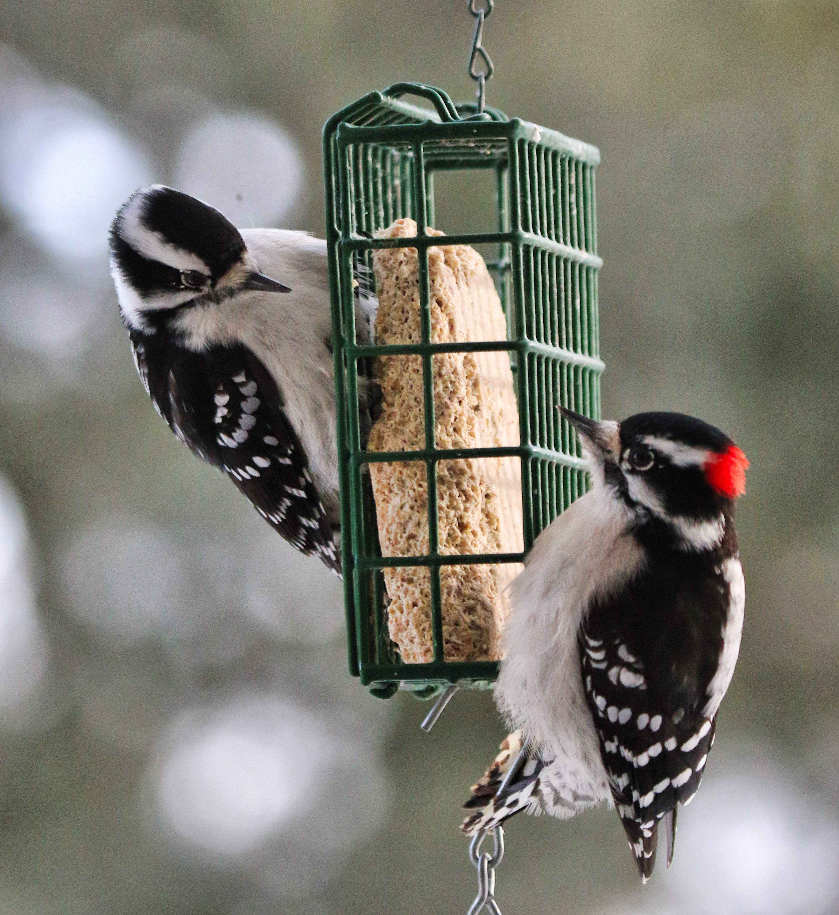

Slide 6
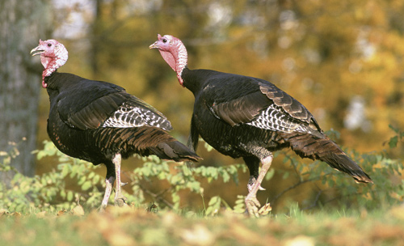

Slide 7
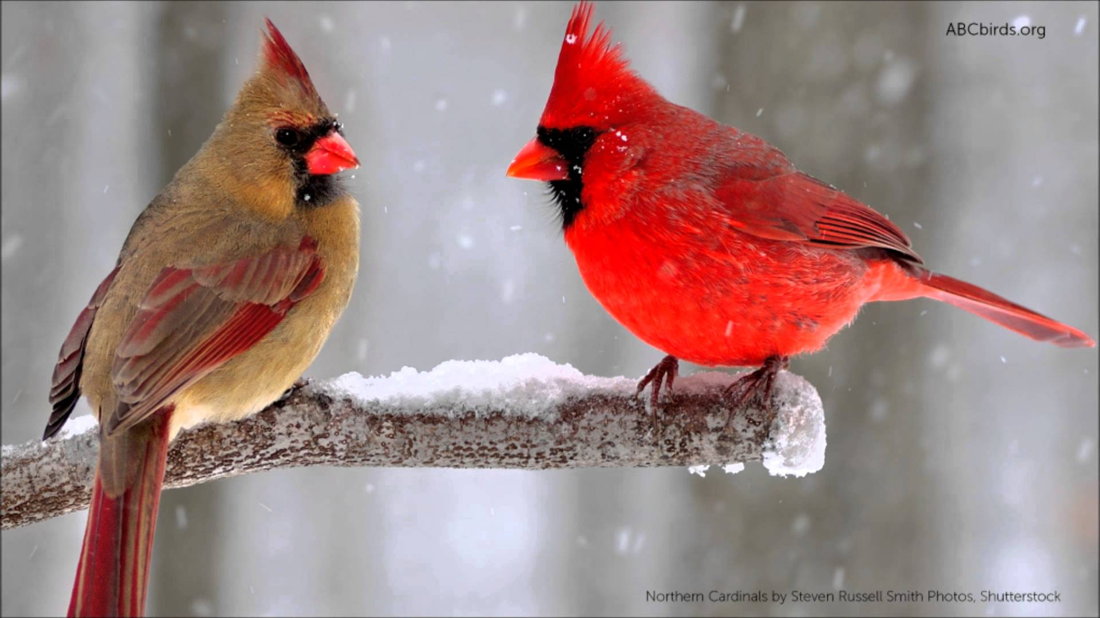

Slide 8
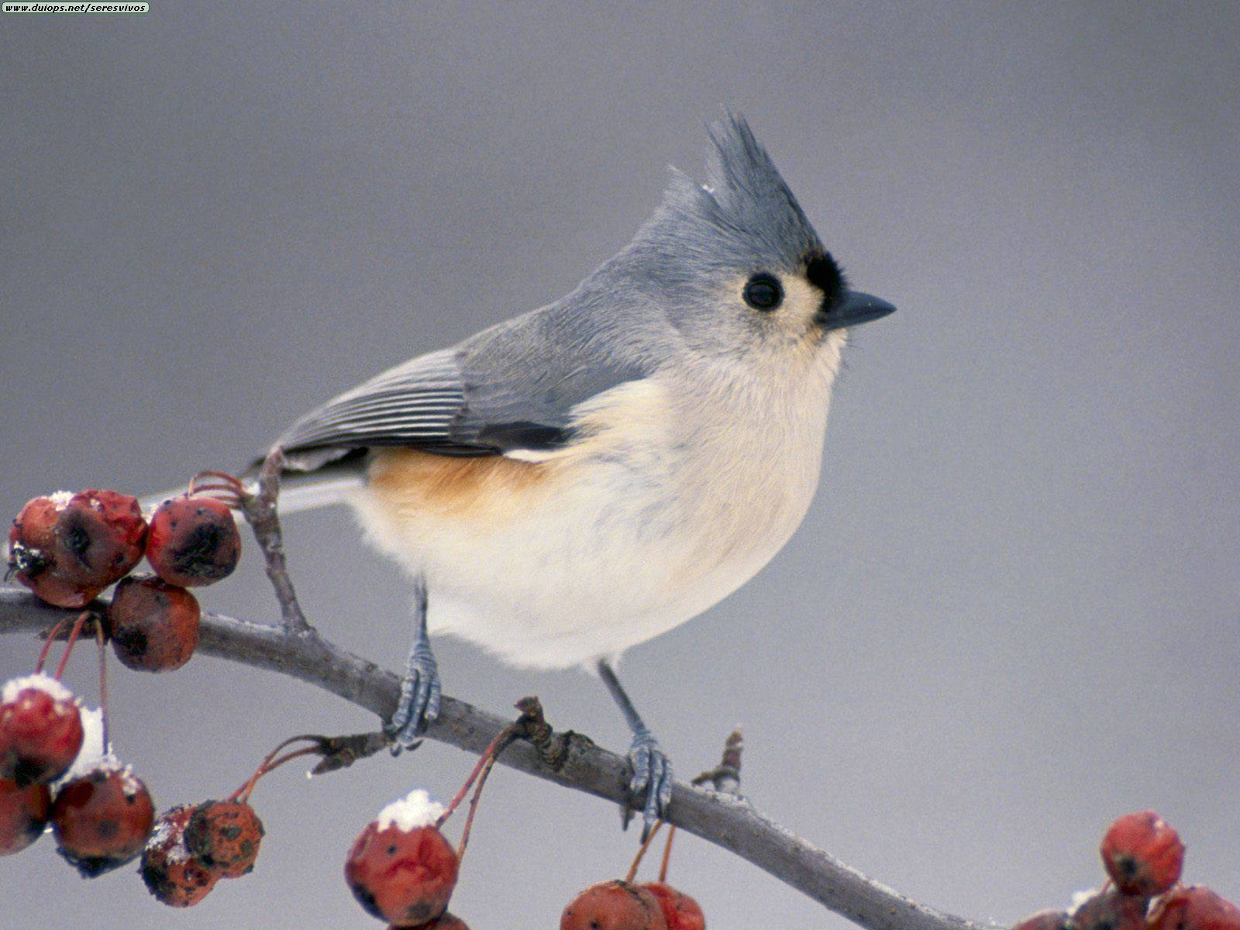

Slide 9
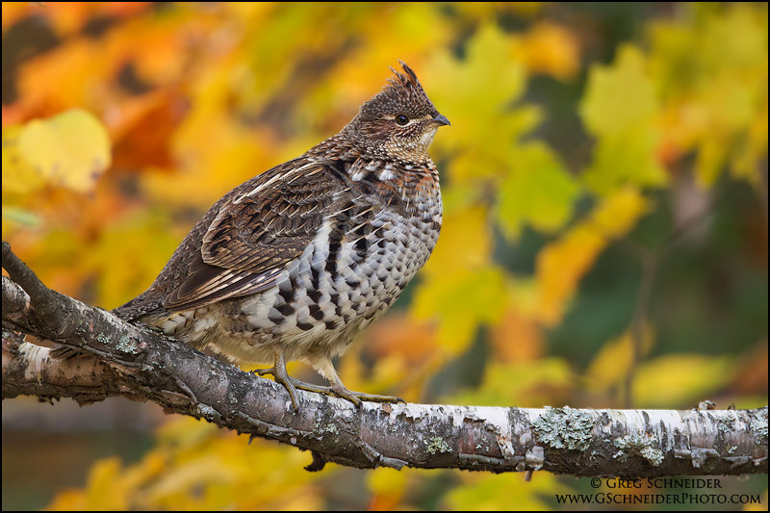

Slide 10
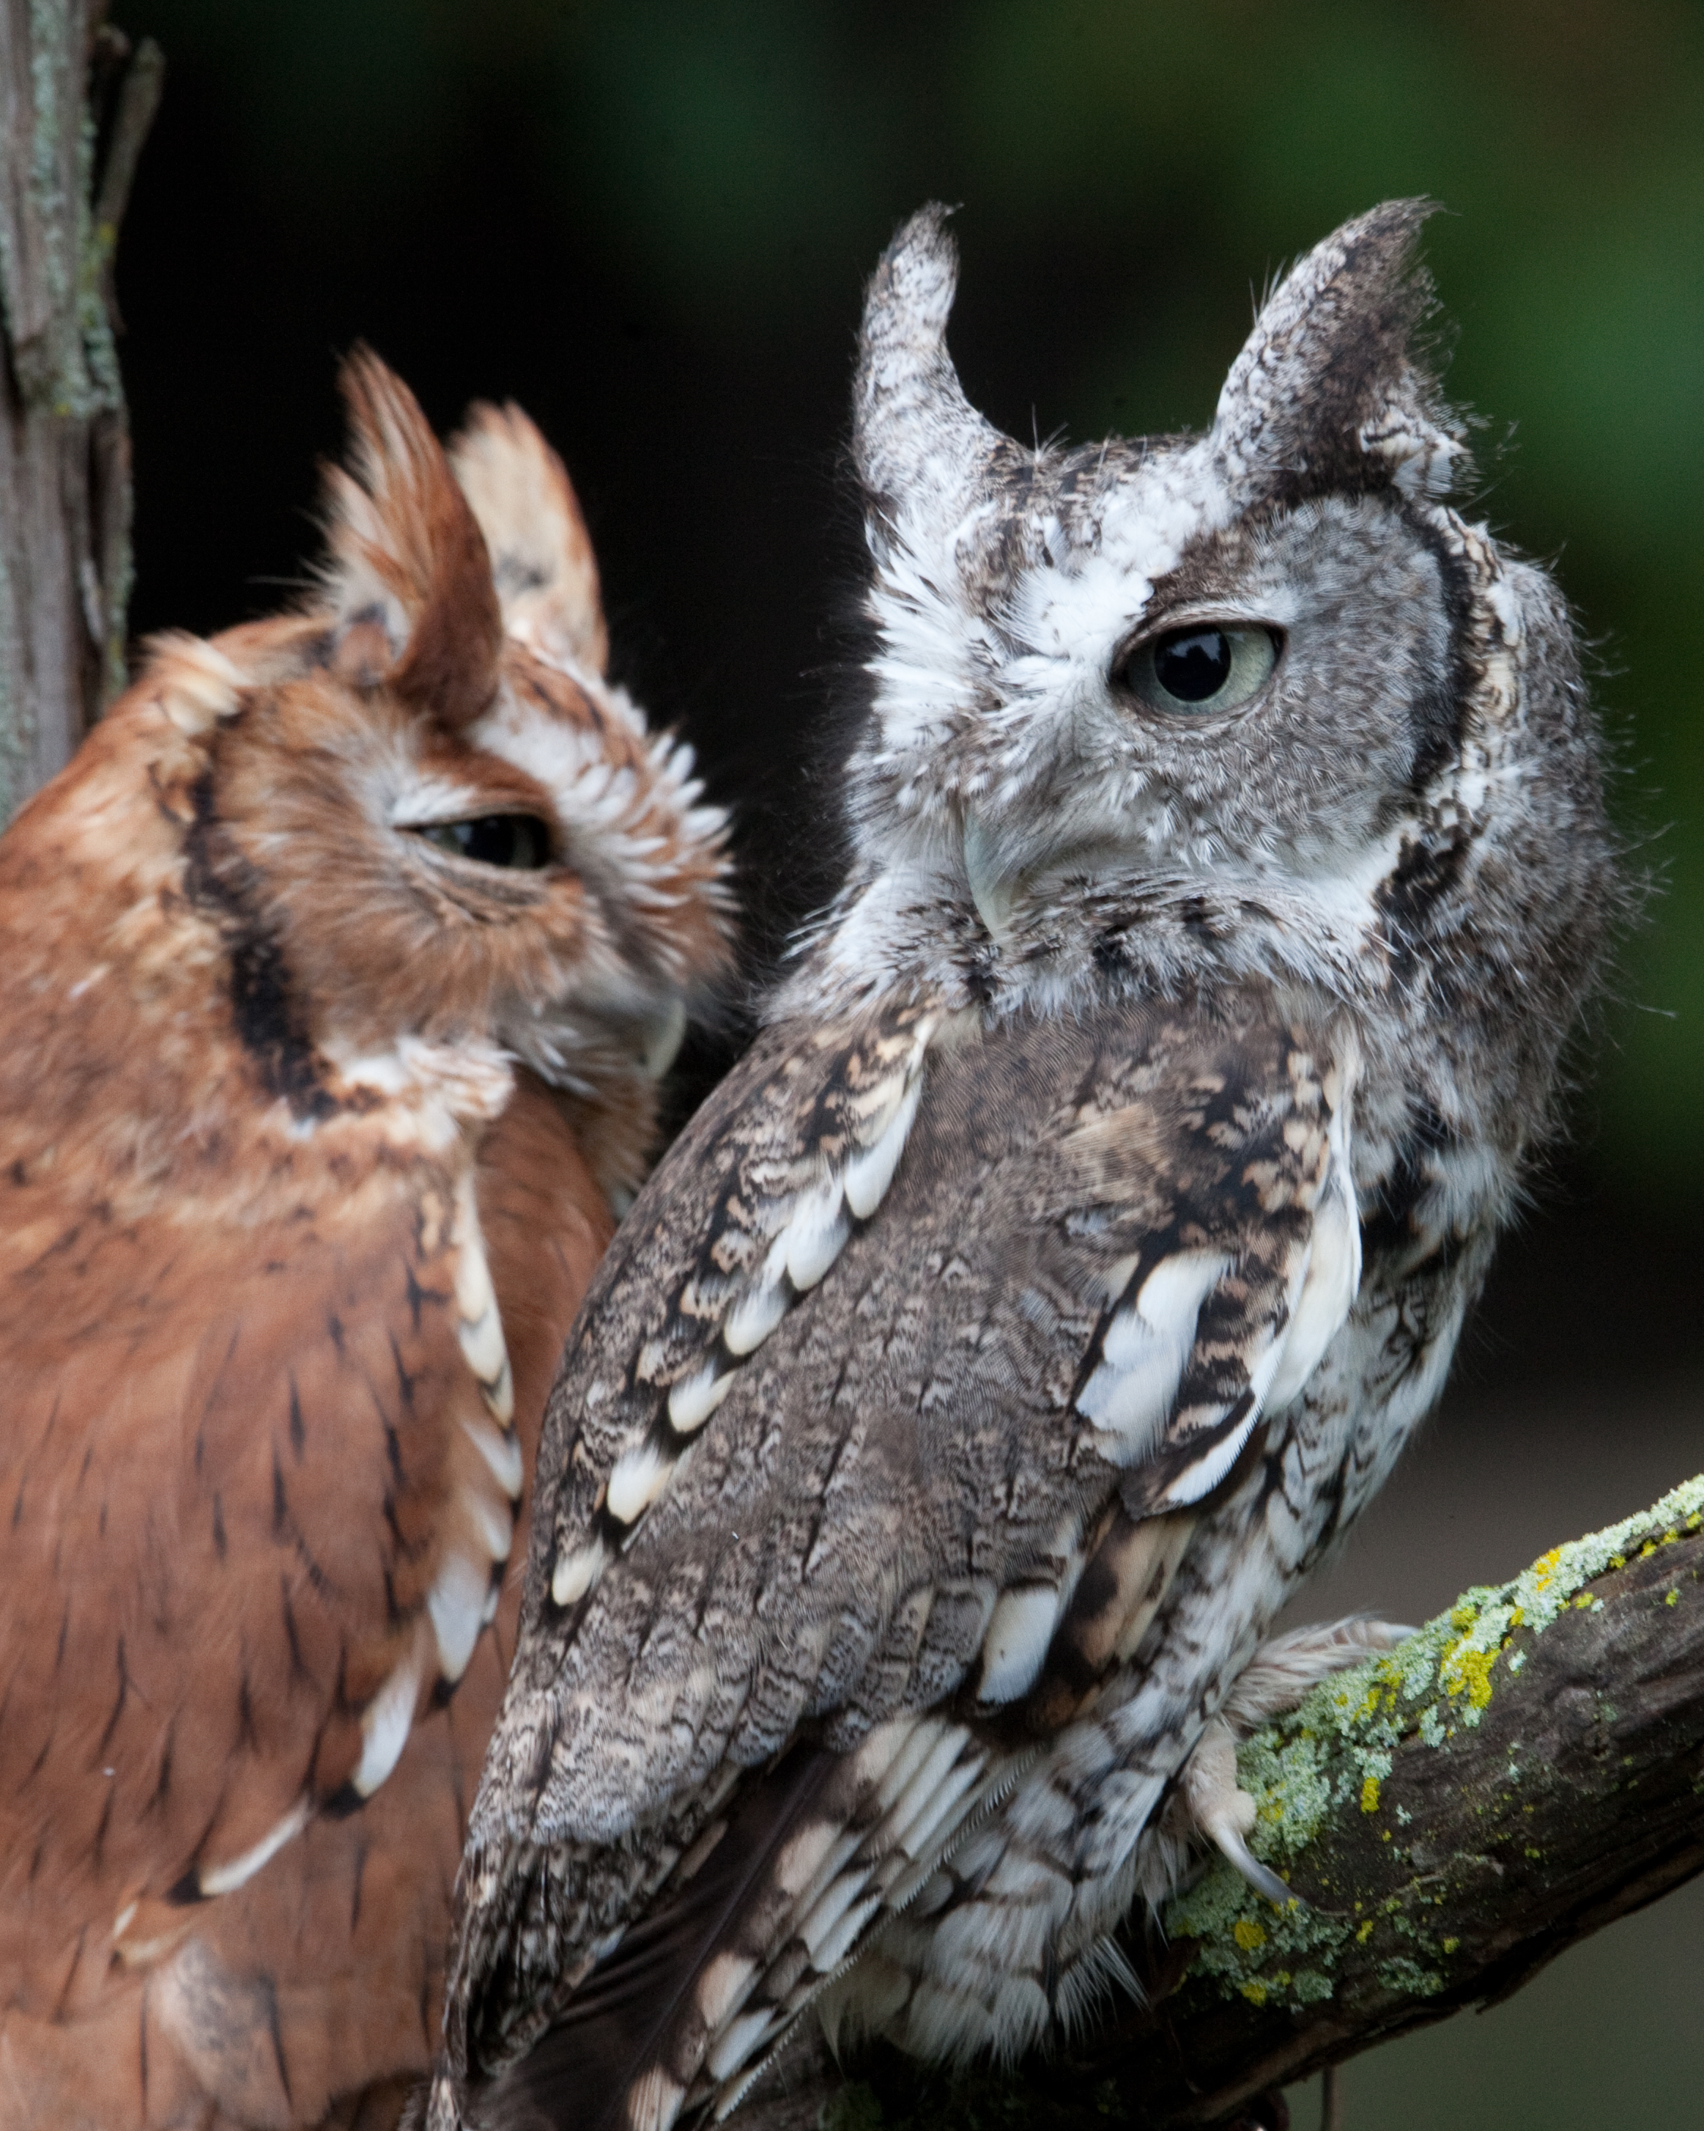

Slide 11
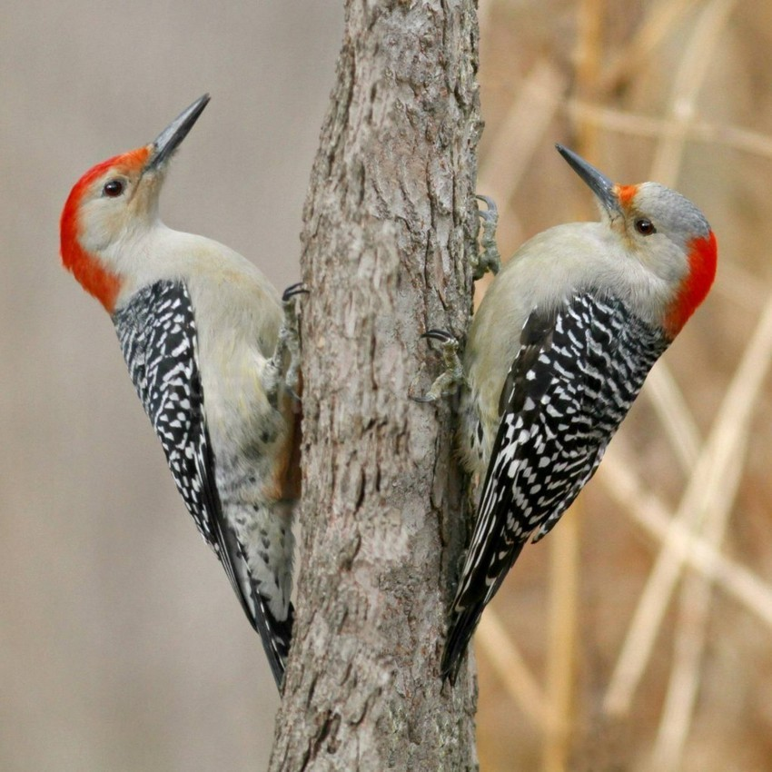

Slide 12
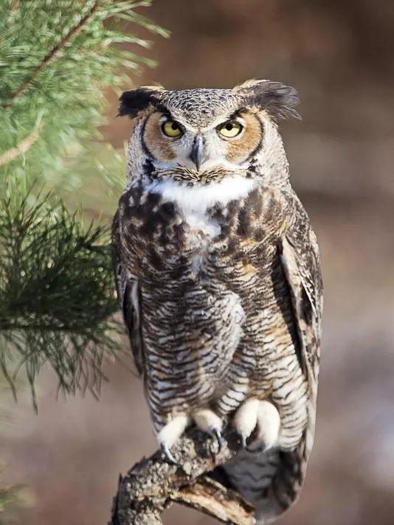

Slide 13
Answer key
2) Blue jay
3) black capped chickadee
4) sharp shinned hawk
5) downy woodpecker
6) wild turkey
7) cardinal
8) tufted titmouse
9) ruffed grouse
10) screech owl
11) red bellied woodpecker
12) great horned owl

